Slide 1
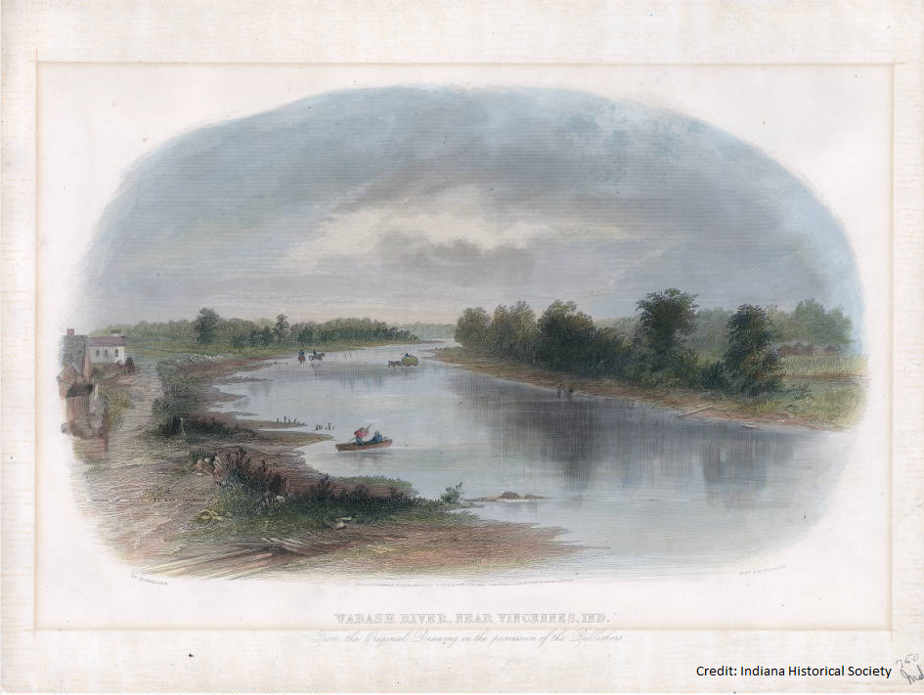
Lost Gems of Indiana
The State of Hoosier
Rivers

Slide 2
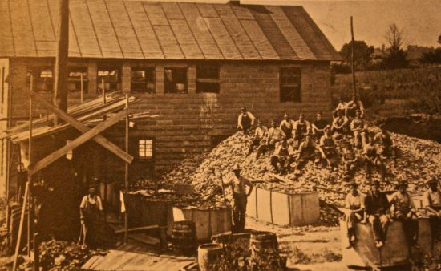
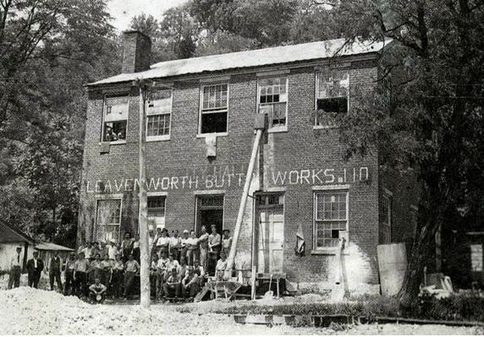
Bonkers for Buttons

Slide 3
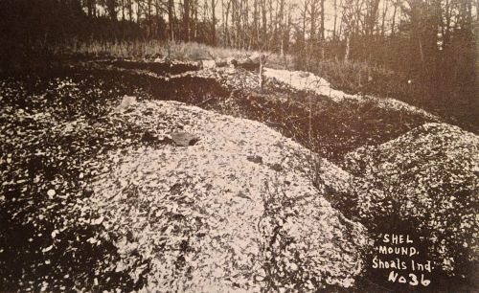
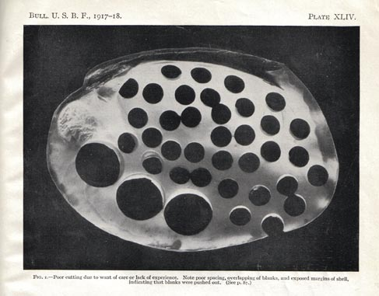

Slide 4
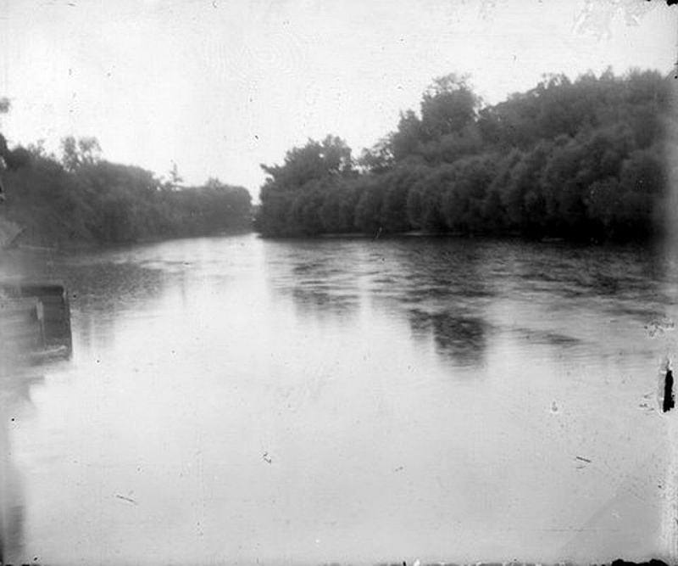
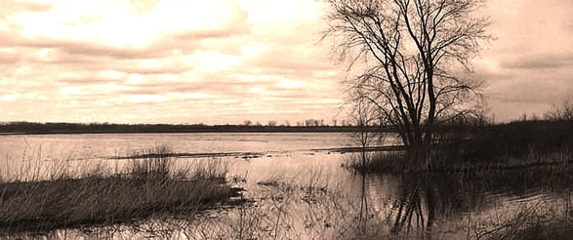
Changes in Hydrologic Function

Slide 5
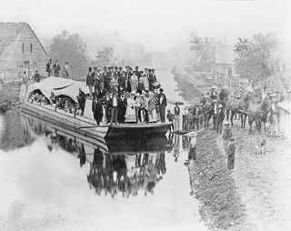
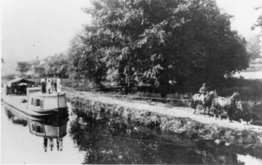
Canal Mania
Between 1805-1837 five major Canals were planned while three were fully constructed
1816 Ohio Falls Canal – Not completed
1827 Wabash and Erie Canal – completed
1833 Whitewater Canal – Completed
1836 Central Canal – Completed
1836 Lake Michigan Erie Canal – Not completed

Slide 6
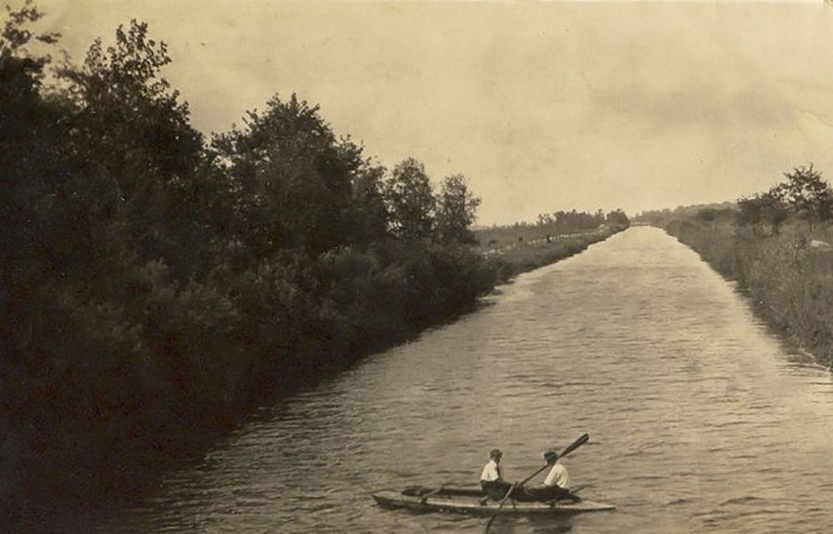
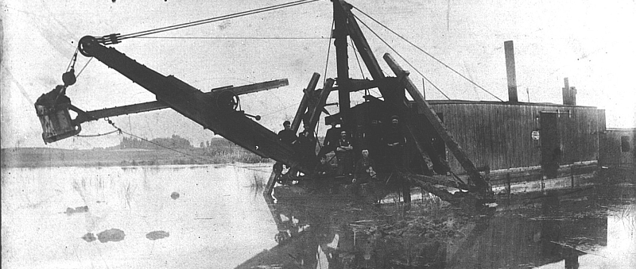

Slide 7
Changes in Species Composition in the Wabash River Watershed

Slide 8
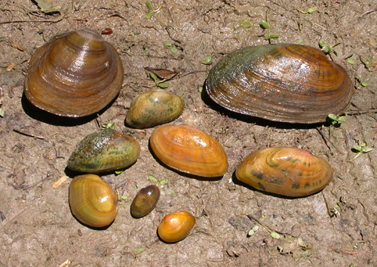
Changes in Species Composition
Over Time
151 native fish species
  7 species now extirpated
73 species of freshwater mussels
  18 are currently believed to be extirpated
http://static1.1.sqspcdn.com/static/f/319113/6007643/1267731631393/5-Freshwater+mussel+list+Fisher.pdf?token=SaX%2Bmtb22DbByncCf3%2FsDH8i9wo%3D
http://ecowatch.com/2012/02/13/two-freshwater-mussels-listed-as-endangered-species/

Slide 9
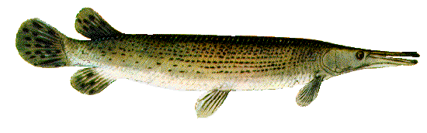
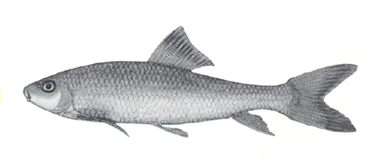
Some Causes of Extirpation
Hydrological modification
Habitat destruction or change
  Amount of water/seasonal changes
  Temperature changes
Competition with invasive species
  Availability of food
  Competing for space
http://www.landbigfish.com/fish/fish.cfm?ID=67
Alligator Gar
http://dinosaurs.about.com/od/otherprehistoriclife/ss/10-Recently-Extinct-Fish_7.htm#step-heading
Harelip Sucker

Slide 10
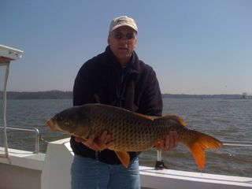

Competing for Resources (Good luck!)
http://animal-kid.com/common-carp-fish.html
http://animal-kid.com/common-carp-fish.html
http://cbf.typepad.com/bay_daily/2009/03/my-entry.html
http://cbf.typepad.com/bay_daily/2009/03/my-entry.html
Common Carp
Goldfish

Slide 11
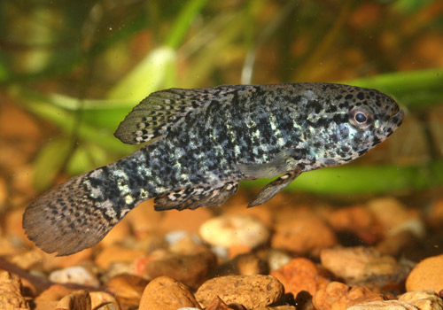
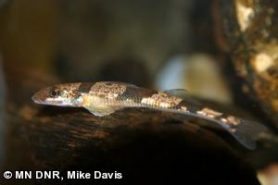
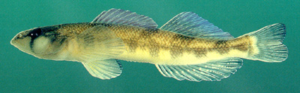

Lost Gems of the Wabash River
http://www.dnr.state.mn.us/rsg/profile.html?action=elementDetail&selectedElement=AFCQC01010
http://www.fishchannel.com/fish-exclusives/fama/conservation-corner/pygmy-sunfish-elassoma.aspx
Banded Pygmy
Crystal Darter
http://wildlife.ohiodnr.gov/species-and-habitats/species-guide-index/fish/popeye-shiner
http://www.outdooralabama.com/saddleback
Popeye Shiner
Saddleback Darter

Slide 12
What can you do?
Educate yourself and others
Get (or Stay) involved
  Nature Conservancy’s Wabash River Initiative
Enjoy the river in a way that does not place unnecessary pressure on the ecosystem
And Finally…

Slide 13
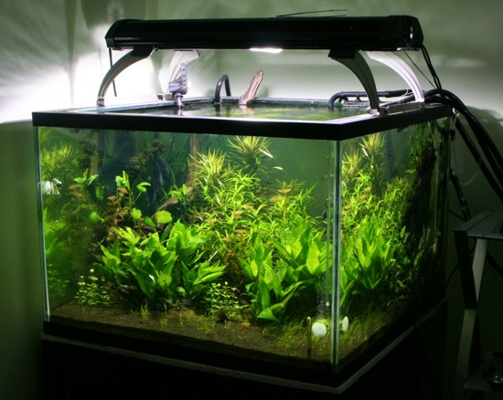
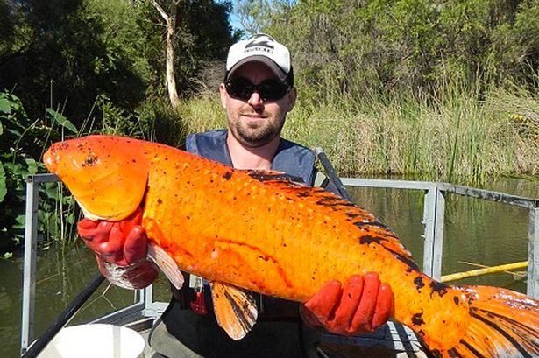
Don’t Dump your fish tank in the River!
http://www.mirror.co.uk/news/weird-news/mutant-goldfish-dumped-rivers-growing-5442241
http://pixshark.com/amazon-river-aquarium-fish.htm

Slide 14
Indiana Dams

Slide 15
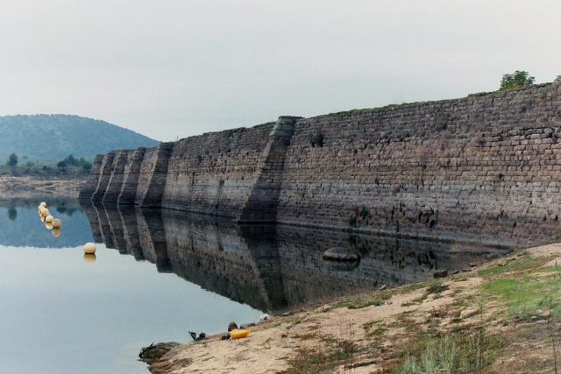
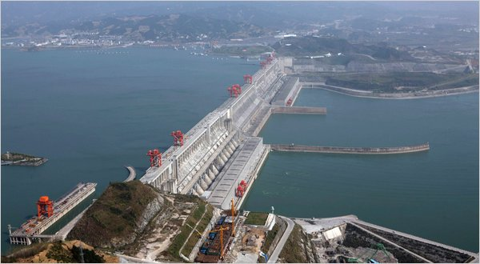
Basic Information About Dams
The Egyptians built the first dams in the Nile River 4000 years ago.
The Romans were able to build bigger and better dams with their invention of concrete and their water proof hydraulic mortar.
The Romans are the father of the modern dams.
There are about 75,000 dams in the United States.
The biggest dam in the world is the Three Gorges dam in China. It is 574 feet tall.
Notes:
Tigris and Euphrates

Slide 16
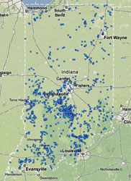
Indiana Dams
Indiana dams are mostly used for recreational, flood control, and hydroelectric purposes.
There are 23 major dams or dams that are 50 feet or higher.
The majority of Indiana dams are less than 50 feet.
Most of the dams in Indiana were built in the 1940s, 50s, 60s, and 70s.
A map of all the dams in Indiana.

Slide 17
The Benefits of a Dam
Provide hydroelectric power to the area that surrounds the dam.
Provides drinking water and recreation for a community.
Helps prevent flooding downstream, which reduces the cost of flood damage.
Can help unnavigable rivers become navigable.

Slide 18
The Four Jewel Dams
Brookville Dam
Geist Reservoir
Grand Rapids Dam
Lake Monroe Dam

Slide 19
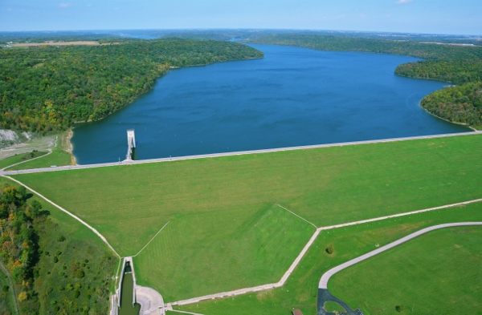
The Brookville Dam
Brookville Dam is an embankment dam.
It was constructed in 1974 with a height of 181 feet and is 2800 feet long.
It is located in the Whitewater River Watershed near Brookville, IN.
This dam’s primary concerns was flood control, drinking water and recreation.
Its capacity is 359,600 acre feet and at normal storage is 184,900 acre feet. It drains an area of 379 square miles and it holds 6,731,700 gallons of water.
Notes:
Earthen dams are made up of compacted earth. With an impermeable center such as concrete or clay.

Slide 20
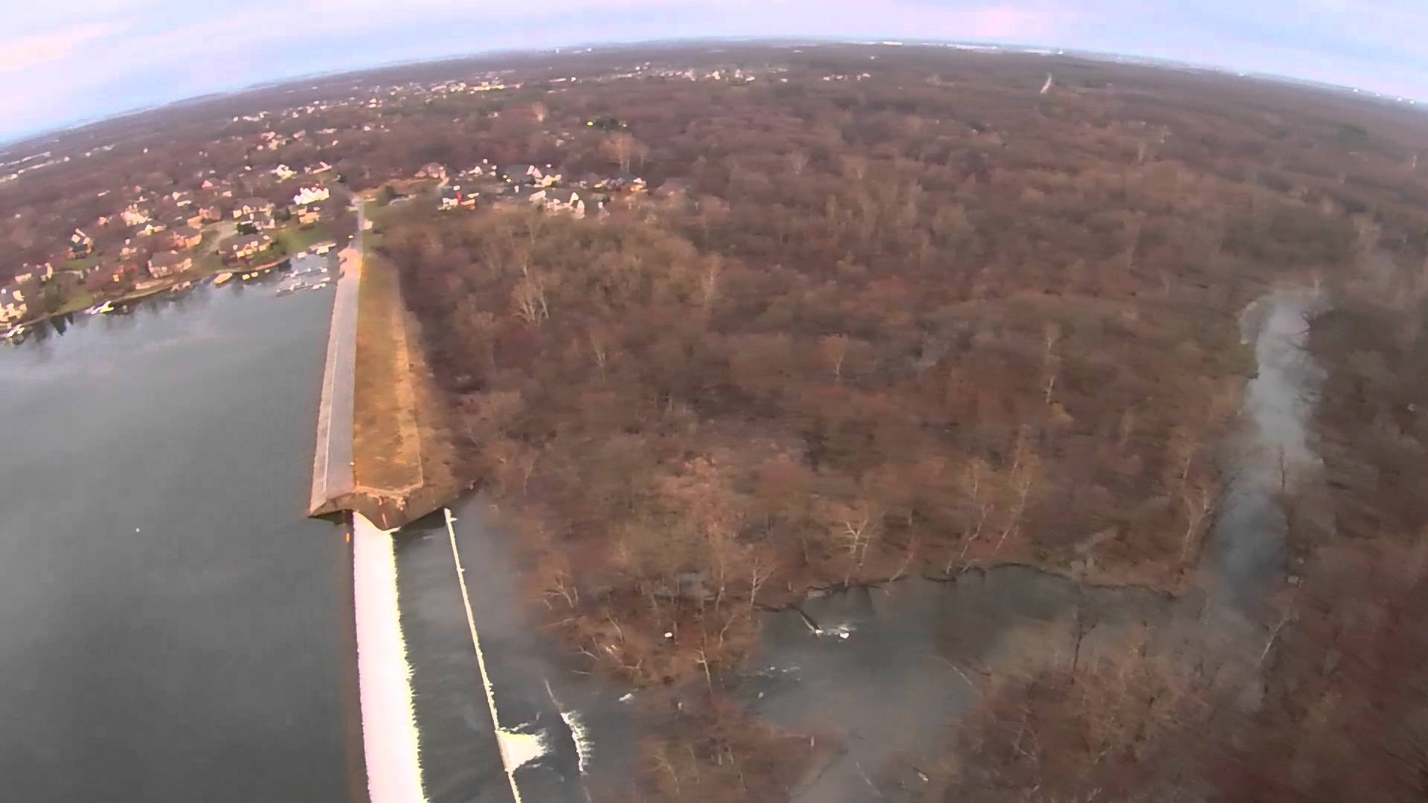
Geist Reservoir
Geist Reservoir is an embankment dam.
It was constructed in 1943 with a height of 44 feet and a length of 1,400 feet.
It is the second largest man made lake in Indiana.
They built this reservoir due to the population increase in Indianapolis.
It is located on Fall Creek in Marion, Hamilton, and Hancock counties.
Their primary concern for this dam is drinking water.
The reservoir capacity is 60,000 acre feet and at normal storage it is 21,180 acre feet. It holds 6,100,000,000 gallons of water

Slide 21
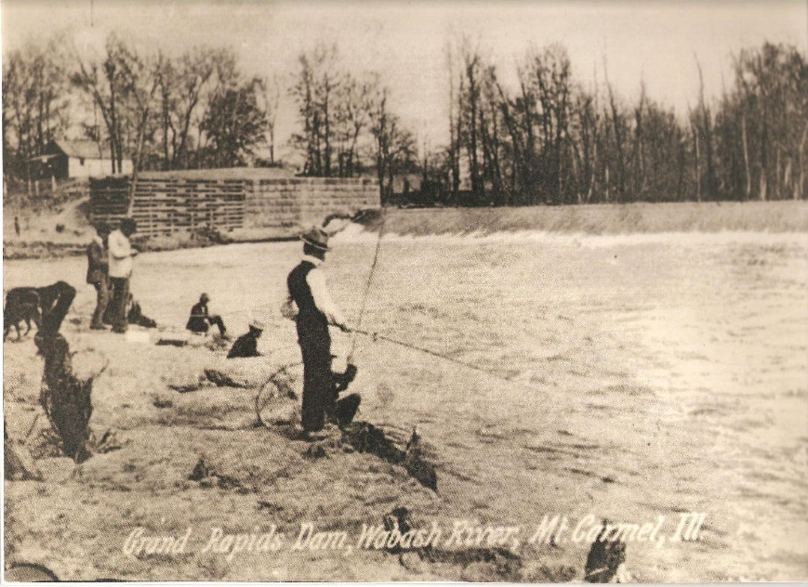
Grand Rapids Dam
Grand Rapids Dam was a concrete-and –stone lock and dam.
Construction started in 1849 but was not finished until 1897.
They built this dam to help improve navigation on the Wabash River.
It is located near Vincennes, IN and Mount Carmel, IL.
It cost a total of $260,000.
This dam was a popular tourist attraction especially for fishermen.

Slide 22
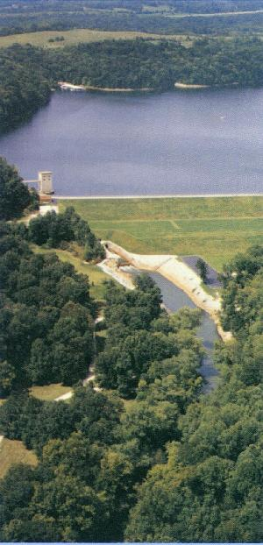
Lake Monroe Dam
Lake Monroe is an embankment dam
They started construction in 1960 and ended construction in 1965.
This lake is found in Monroe, Brown, and Jackson Counties near Bloomington, IN.
This dam was constructed for flood control. It was actually authorized by the Flood Control Act of 1938.
This dam cost $16.5 million, but it potential saved $38 million in flood damage.
Its maximum capacity is 347,000 acre-feet and its normal capacity is 237,000 acre-feet.

Slide 23
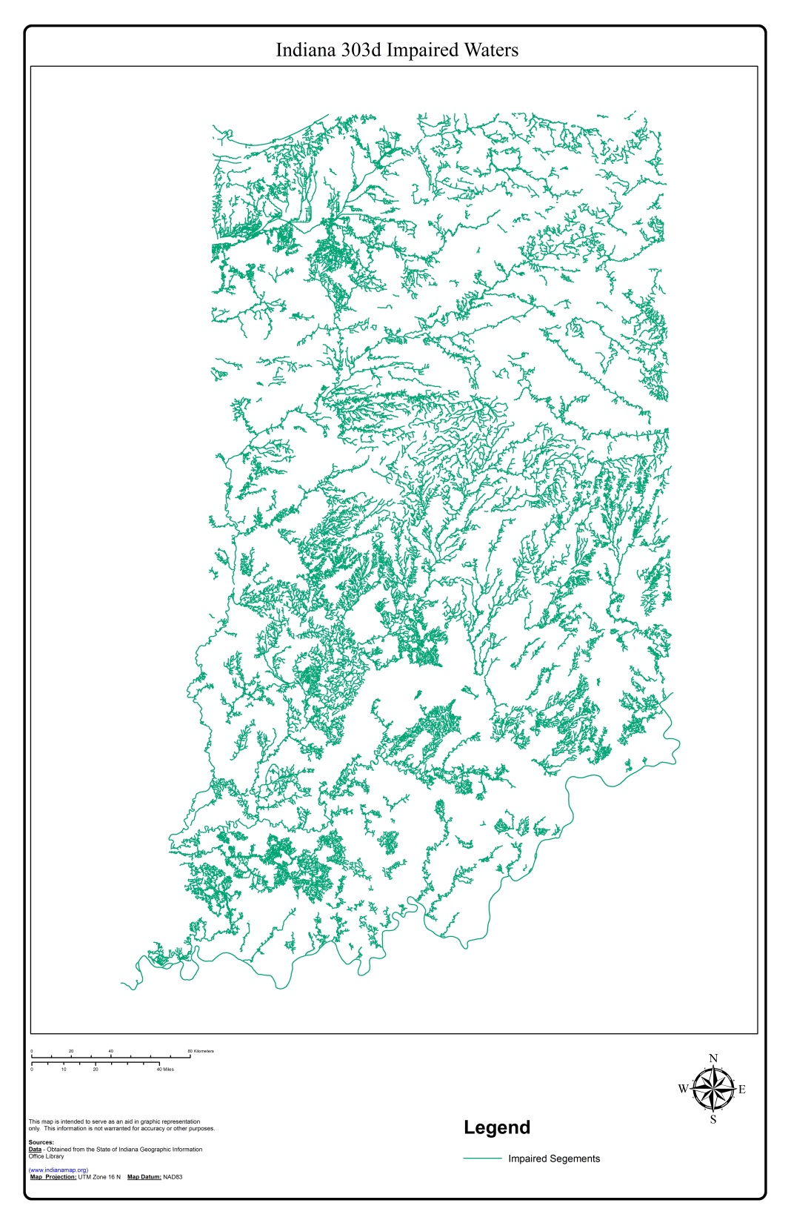

Slide 24
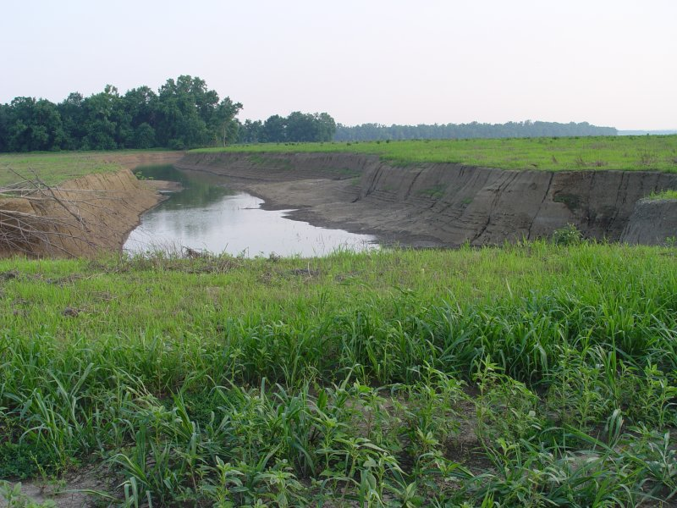
Continual Evolution

Slide 25
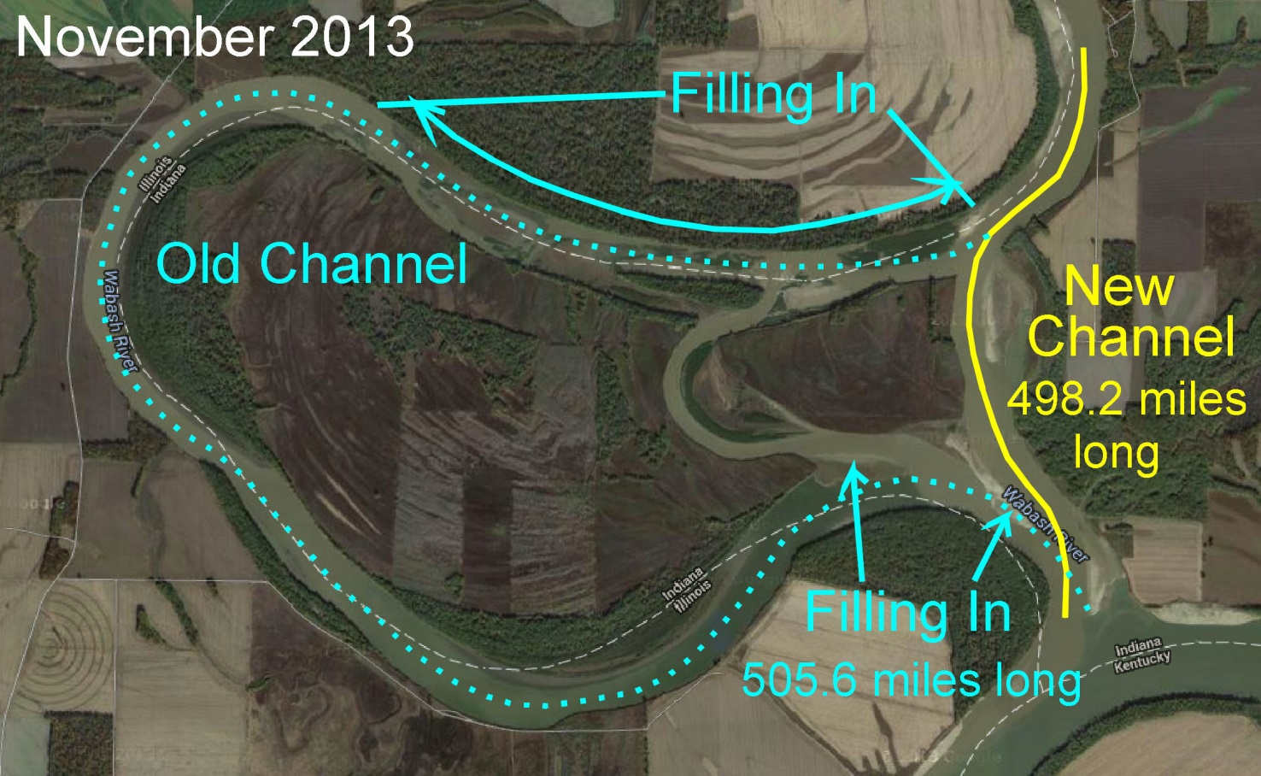

Slide 26
To be continued……

